Slide 1

Machine Learning Fundamentals
Workshop 4

Slide 2
Content
Machine Learning overview
Linear Regression (Regression)
Logistic Regression (Classification)

Slide 3
A. Introduction
What is machine learning？
Supervised and unsupervised learning

Slide 4

1.What is machine learning
“Fields of study that gives computer the ability to learn without being clearly programmed”
— Arthur Samuel(1959)
Notes:
"Back to 1959, Arthur, a pioneer in the field of artificial intelligence, defined machine learning as a 'Field of study that gives computers the ability to learn without being clearly programmed.' In simpler terms, machine learning allows computers to learn from data and improve their performance without human intervention."
He is famous for a checkers playing program. And the amazing thing about this program Was author himself was not a very good checkers player. And what he did was He let the computer to play the checkers many, many times against itself. And by watching what kind of board position Tend to win and what kind of board position tend to Lead to losses. By trying to achieve the good position and avoid the bad position. The program Learned better and better in playing checkers. And finally become a better checker player than arthur
---

Slide 5
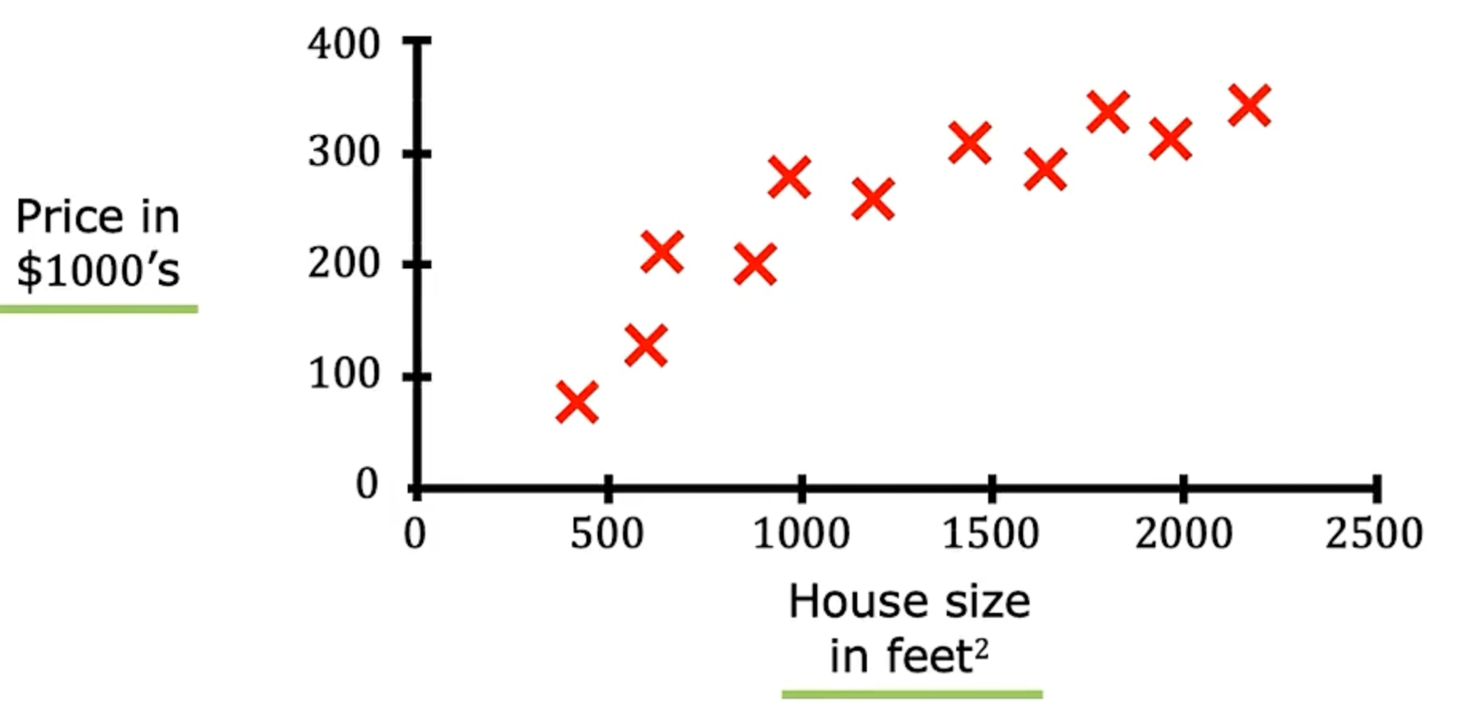
2. Supervised learning and unsupervised learning
Supervised learning example:
1)Predicting house prices based on features like size
2)Predicting whether a student will be admitted (1) or not (0) to a university based on their exam scores.
3)Classifying emails as spam or not spam based on their content.
X Y
Input data → Output label
Learns from being given ‘right answers’
Notes:
"Let's start with a type of machine learning called 'Supervised Learning'. In supervised learning, the machine learns from labeled data. The labeled data means we provide the algorithm with input-output pairs, which is X and Y respectively. And we try to find a pattern between the input and output, and given a new input we can use it to predict the output.
The concept maybe a bit abstract, let me clarify this concept by a few examples:
1. "Imagine you want to predict the price of a house based on its size. We would provide the machine with historical data where the sizes of houses and their respective prices are known. Using this data, the machine would learn the relationship between house size and price."
2. "Another example would be predicting university admissions. Let's say we want to predict if a student will be admitted or not to a university based on their exam scores. By training our model on historical data of students and their admission statuses, our machine can make predictions for new students."
3. "Lastly, consider an email system that classifies emails as spam or not. The system is trained on emails where we already know if they're spam or not. Once trained, it can classify new emails accurately."
So in one sentence to summarize the supervised learning algorithm "Learns from being given the 'right answers'."

Slide 6
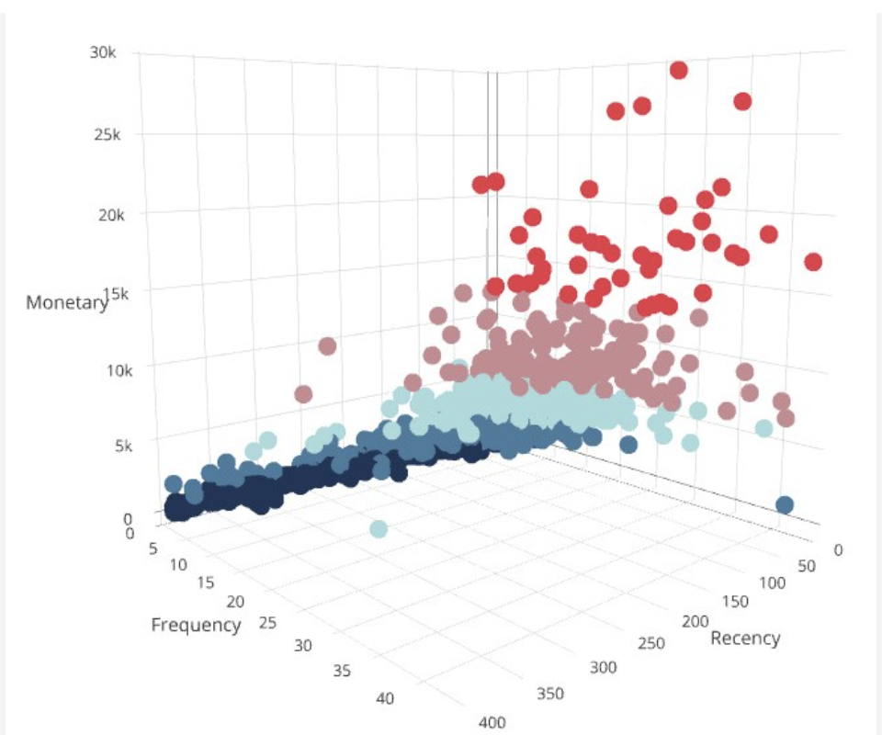
Unsupervised learning example:
Segmenting customers into different groups based on their purchasing behavior without prior knowledge of any group definitions.
Grouping without given any label or ‘right answer’.
Notes:
"Now, let's move on to another type of machine learning called 'Unsupervised Learning'. Here, the machine learns from unlabeled data. The goal is not to predict a specific output but to discover patterns or structures within the data."
"For example, imagine a campany wanting to segment customers based on their purchasing behavior. We don't know in advance what these segments or groups might be. Unsupervised learning would help the retailer find these customer groups without any prior definitions."
So in one short sentence, unsupervised learning is "Grouping without given any label or 'right answer'."

Slide 7
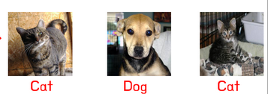
One example to understand the difference
Supervised: Data with label, try to predict, extrapolate
Non-supervised: Data with no label, try to group them meaningfully
Given
Data
Task
Group 1
Group 2

Slide 8
A quick summary:
1)Supervised learning:
Definition: In supervised learning, an algorithm learns from labeled training data, and makes predictions based on that data.
Goal: The primary goal is to learn a mapping from inputs to outputs and to be able to make predictions on new, unseen data.
Common Algorithms: Some common supervised learning algorithms include linear regression, logistic regression, decision tree Support Vector Machines (SVM), random forest an so on.
2)Unsupervised learning:
Definition: In unsupervised learning, an algorithm learns from unlabeled data, finding hidden structures in the data without given any label.
Goal: The main goals can be to find clusters within the data (clustering)
Common Algorithms: k-means,
Notes:
1)Supervised,
Definition: In supervised learning, an algorithm learns from labeled training data, and makes predictions based on that data.
Goal: The primary goal is to learn a mapping from inputs to outputs and to be able to make predictions on new, unseen data.
Common Algorithms: Some common supervised learning algorithms include linear regression, logistic regression, decision tree Support Vector Machines (SVM), random forest an so on.
2)Unsupervised
Definition: In unsupervised learning, an algorithm learns from unlabeled data, finding hidden structures in the data without given any label.
Goal: The main goals can be to find clusters within the data (clustering)
Common Algorithms: Common unsupervised learning algorithms include k-means clustering,
---
And today we will focus on the three algorithm under the supervised learning, because these will help a lot in the next week’s workshop focus on deep learning.
So basically there are three main topics today, linear regression, logistic regression and decision tree. I will cover the theory and concept part, as well as some math behind the algorithm, and Huy will demonstrate some code implementation.
7:30

Slide 9
B. Linear Regression
Define the dataset
Model
Loss function
Notes:
Alright, next we'll dive into the topic of linear regression. This topic mainly consists of three parts. Firstly, we need to define our dataset, which I personally believe is a crucial step. This is because understanding the dataset isn't always as straightforward as we might think. Secondly, we'll talk about the linear regression model itself. And thirdly, we'll delve into the details of the loss function.

Slide 10
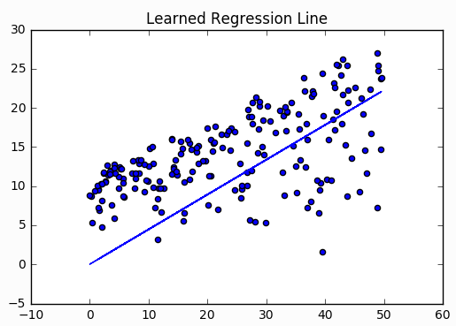
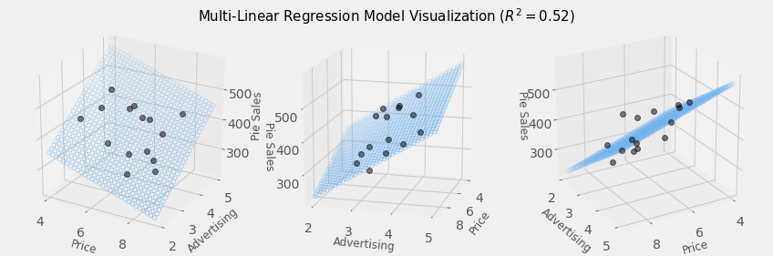


Linear Regression: “hyperplane” fitting
Single variable
Multi variables (2 variables in this case)

Slide 11
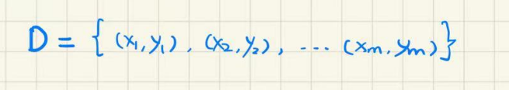
Define the dataset
Recall:
Linear Regression is a supervised learning
Supervised learning has Input data X and Output label Y
So the dataset D can be written as:
Note: the X is Not always a single number
Notes:
Let's start with defining the dataset. To recap what we just learned about supervised learning: Linear regression is a method of supervised learning. In supervised learning, we have input data 'x' and output labels 'y'. So, our dataset can be represented as a collection of xy pairs, like this: dataset 'd' equals pairs x1y1 to xmym. As shown in the illustration on the right, 'x' represents the horizontal axis, in this case, the area of a house, and 'y' represents the vertical axis, which is the price. Each point on this graph is a data point, and collectively they form the dataset. But this is a very simplified scenario. In reality, 'x' isn't always just one number. In our example, 'x' is the house area, but 'x' can also be a set of numbers, as we'll explain with the following example.

Slide 12
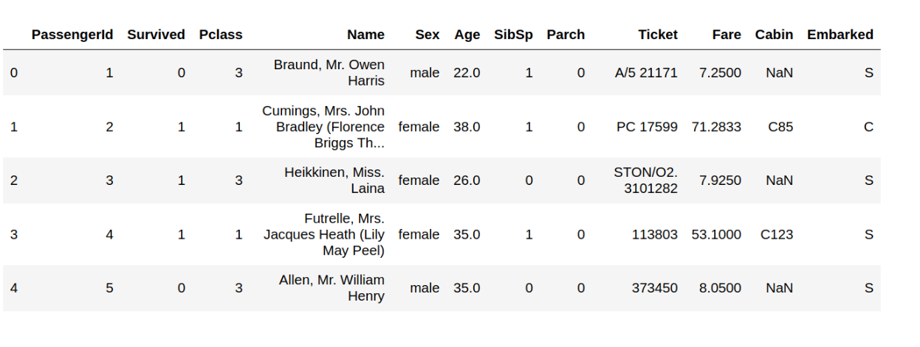
Let’s look at this example, where X is not a single number.
X
Y
X1
X2
X3
X4
X5
The X1…X5….Xm are the samples. In this scenario, they are the passengers.
Each samples has d attributes, which are the columns
The column ‘Survived’ is the result or output and thus is the Y, which is composed by y1,y2...ym
Notes:
We'll use a well-known dataset in machine learning: the Titanic dataset, which contains information on survivors and non-survivors of the Titanic disaster. Analyzing this table, the first column is an ID, ranging from 0, 1, 2, 3, 4, and so on, only a portion is displayed here. Each row represents a passenger and shows various pieces of information about them. The column labeled "survive" indicates whether the passenger survived. It's easy to infer that the "survive" column is our 'y', so the first entry is y1, the second is y2, and so forth. Each passenger can be seen as an input. However, as mentioned, this input isn't just a single number. In fact, each input has 'd' attributes. For example, for input x1, it has several attributes. In total, there are 'm' inputs, and these 'm' inputs are called samples. Each sample has 'd' attributes.

Slide 13
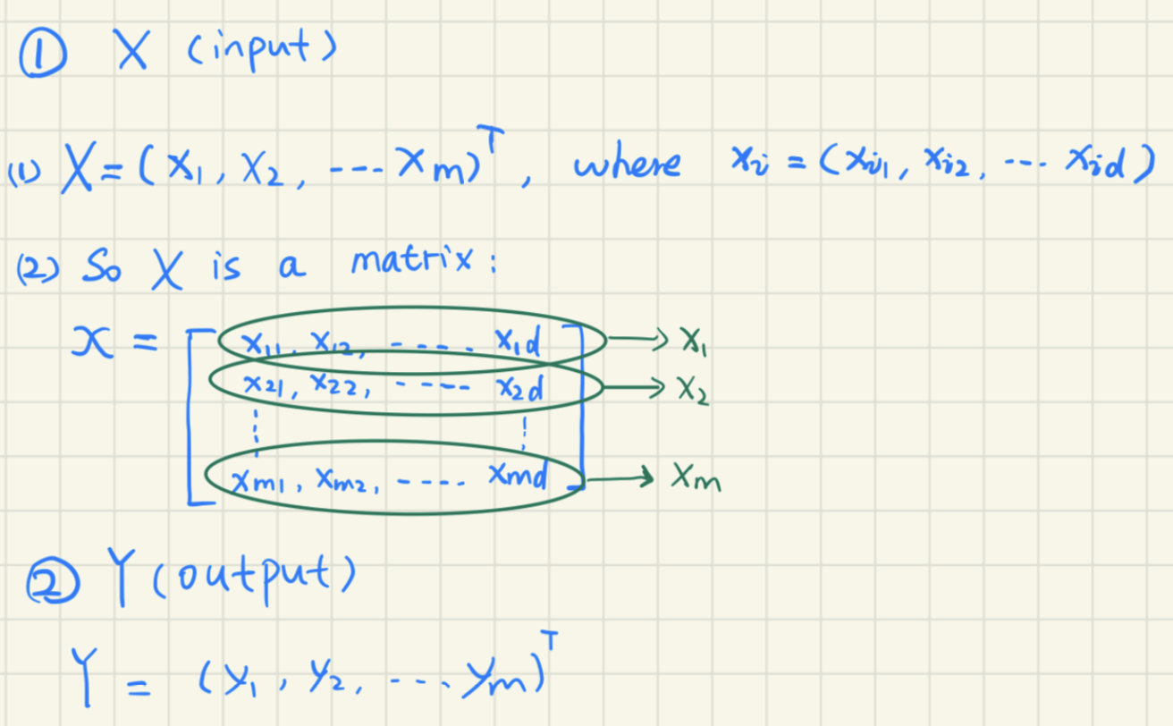
Mathematically, it is defined as:
Here X1, X2, … Xm
are datapoints (or samples)
Notes:
Let's define this mathematically. If uppercase X represents the entire input, then it consists of M inputs. Each input Xi will have 'd' attributes, as we saw earlier. Here, the whole input set X is formed by 'm' samples, and each individual input has these attributes. So, in reality, the entire input X is a matrix, represented as such: each row is a sample and each column is an attribute. As for 'y', the labels, they are relatively simpler. Typically, 'y' is either a single value or a categorical variable.

Slide 14
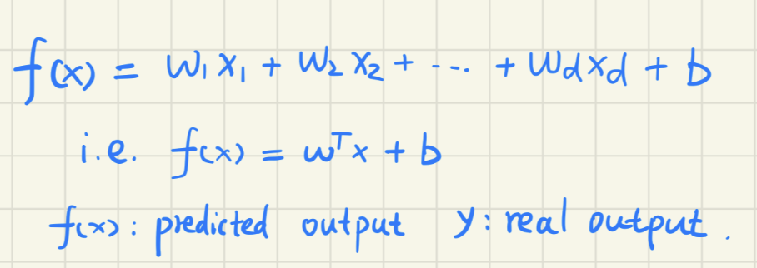
2. Model
The linear regression function is given here, and for each sample with d attributes input, it will give a predicted f(x) according to this function.
The w and b here are the parameter and we need to find the optimal parameter value of them to fit the given data best.
Notes:
Alright, let's continue with the translation, ensuring it remains at a high school level of understanding:
Alright, next, we'll look at the linear regression model. This model predicts the output, or the corresponding 'y' value, based on the first attribute. Here, 'Fx' represents the predicted 'y' value, or the forecasted output. In contrast, 'y' is generally used to represent the actual output. This model is computed for a single sample, meaning just one row like in the example we discussed earlier. We input the 'dth' numeric variable, while 'W' and 'b' are the values we aim to optimize during the learning process. Once we find the best 'W' and 'b', we can input the 'dth' attribute to get the predicted output value.

Slide 15
Columns: features
X1, … Xd are features with different weights
X
X1
X2
Xd
Rows: Data points
…
Each data point row has a corresponding prediction in f(X) vector
f(X)
X1
X2
Xd
b
= w1
+w2
+ ... +wd
+
Weights
Bias

Slide 16
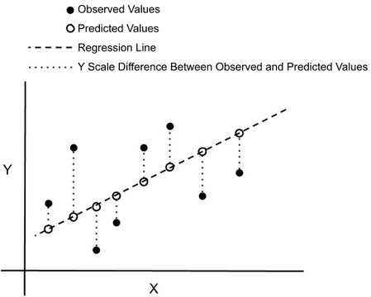
3. Cost (Loss) function
How to find the best value of the parameter?
Aim → minimize the ‘error’ between the predicted value and real value.
MSE is the most common indicator to show the model’s performance.
So, we try to find the parameters that allows the MSE of this model has the minimal value.
In this context, MSE is the loss function
*MSE refers to mean square error
Notes:
In essence, we've identified our goal: to train a linear regression model, which means finding the optimal values for 'W' and 'b'. How do we determine these optimal values? Our primary objective is to reduce error, specifically the error between the predicted and actual values. As illustrated in the given graph, the line represents our predictions while the black dots show the actual values. To minimize the overall error, we often use the mean squared error (MSE). In this context, MSE is our loss function. So, our task is to find parameter values that minimize the MSE.

Slide 17
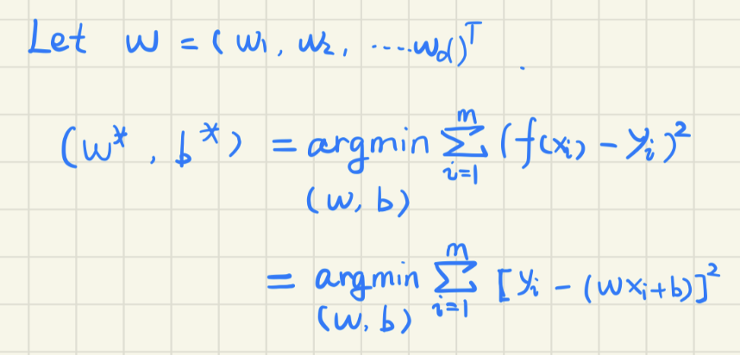
Mathematically, it is defined as:
Loss function
(When each sample only has one attribute)
Note:
1)‘argmin’ used to describe the argument, for which a given function attains its minimum value.
2)w*,b* means the optimal value of w and b.
Notes:
To define this mathematically, we denote 'W' as such because each attribute can have different weights. Our optimal 'W' and 'b' can be determined using a specific formula. The asterisk here indicates the optimal value. The term 'argmin' refers to the argument that minimizes the following expression. This subsequent expression is our loss function: the sum of the squared differences between the true and predicted values. When considering that each sample has only a single attribute, 'yi' can be represented as 'wxi+b'. This expression can then be transformed accordingly. Based on this formula, we can determine 'W' and 'b' using various mathematical methods.

Slide 18
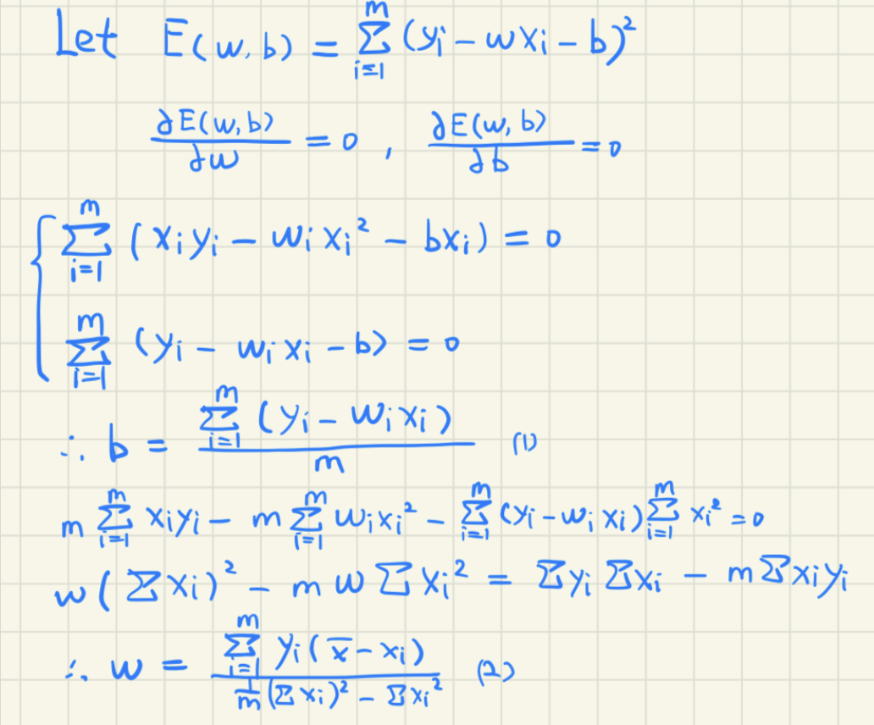
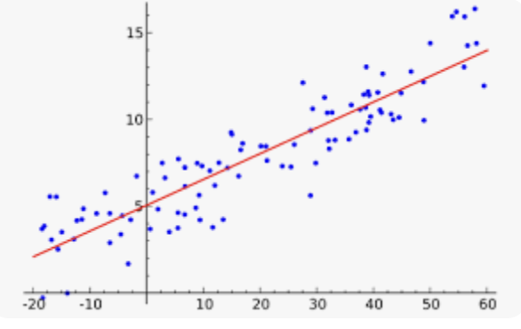
Detailed calculation
f(x) = wx + b
(2)
(1)
Notes:
I won't delve deep into the mathematics here, but I've included the detailed calculations for those interested.

Slide 19
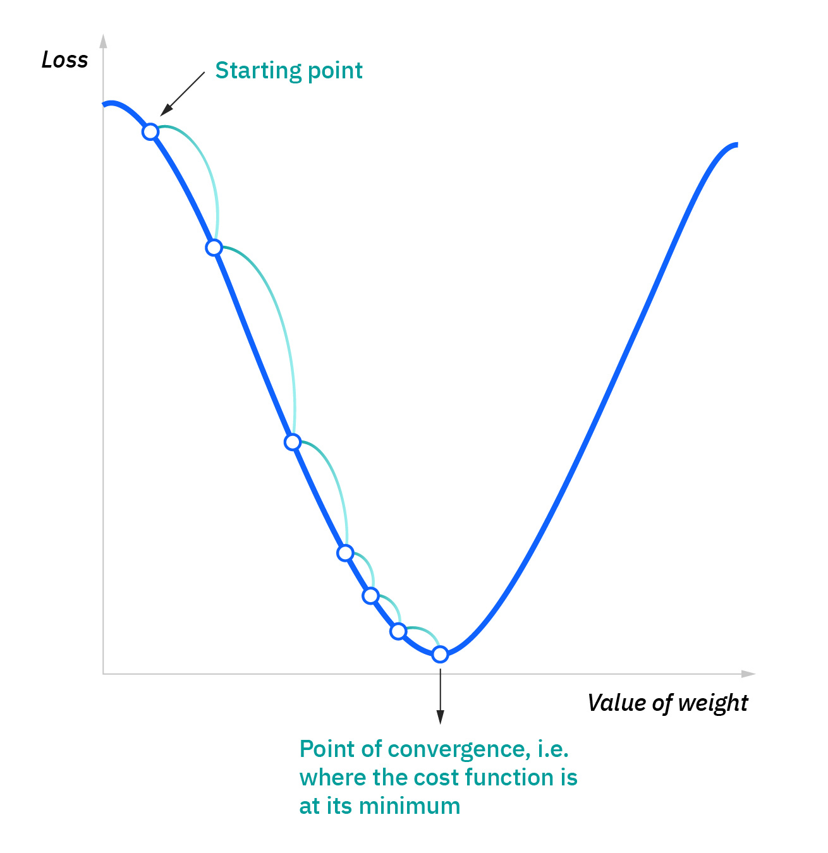
Gradient Descent: use Cost Function to update Weights
Differentiate Cost/Loss against Weight
How a change in weight affect the Cost/Loss
Visualization for 1 weight but this is done for all weights: w1,...wn

Slide 20
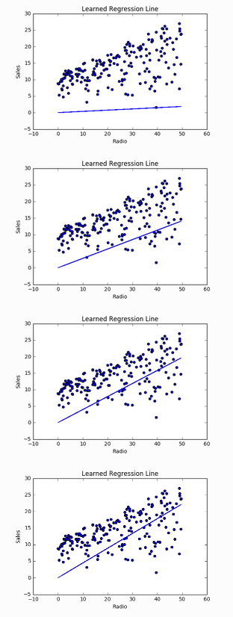
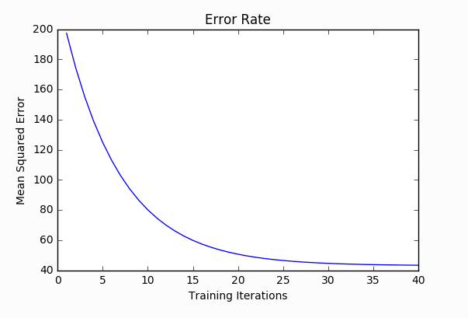
Iterations
Continuously use gradient descent to find the best set of weights: w1, w2, …

Slide 21
A quick summary
1.A dataset is often represented as a matrix, where each row is a different sample and each column is a different attribute.
2.The linear regression model makes a prediction by computing a weighted sum of the input
3.The loss function measures how well the model predicts the Y. For linear regression, the most commonly used loss function is the Mean Squared Error (MSE) loss function, which is the average of the squared differences between the predicted values and the actual values.
Notes:
And here is a quick summary:
1. A dataset is often represented as a matrix, where each row is a different sample and each column is a different attribute.
2.The linear regression model makes a prediction by computing a weighted sum of the input
3.The loss function measures how well the model predicts the Y. For linear regression, the most commonly used loss function is the Mean Squared Error (MSE) loss function, which is the average of the squared differences between the predicted values and the actual values.

Slide 22
C. Logistic Regression
Numeric and categorical variable
What is logistic regression
Example for logistic regression
Difference in logistic and linear regression
Sigmoid function
Application
Notes:
So far, we have a general understanding of linear regression. Now, we're going to discuss a regression problem pivotal in deep learning: logistic regression. In this section, we'll first understand the types of variables, including numeric and categorical variables. Then, we'll learn what logistic regression is, see some examples, and identify the differences between logistic and linear regression. A key focus will be on the sigmoid function, followed by applications of logistic regression.

Slide 23
Numeric and categorical variable
Categorical Variable:
Numeric Variable:
Definition:
Categorical variables represent distinct categories or groups.
They don't have inherent numerical meaning but can have a numerical label
Example: "1" for male and "2" for female.
Definition:
Numeric variables represent measurable quantities
Example: age, height, weight,
Numeric variable
Variable
Categorical variable
Notes:
Firstly, it's important to understand that variables can be classified as numeric or categorical. Numeric variables represent measurable quantities, such as age, height, and weight, which have precise mathematical meanings. On the other hand, categorical variables represent distinct groups or categories. They can be denoted by letters, like 'm' for male and 'f' for female, or even by numbers, like 1 for male and 2 for female. However, even if numbers are used, remember that it's still a categorical variable. These numbers don't carry any computational value; they are merely labels.

Slide 24
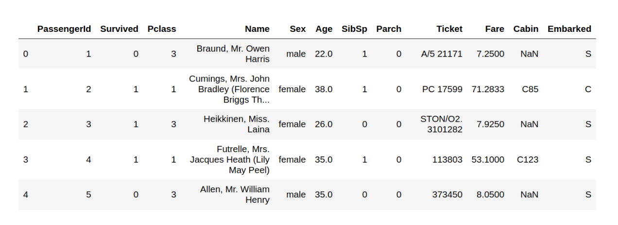
Categorical:
Survived: Whether the passenger survived or not
Pclass: Class of the ticket the passenger purchased
Name: Name of the passenger
Embarked: Port where the passenger boarded the Titanic
Sex Ticket
Numerica:
Age Fare
Parch: Number of parents or children the passenger had aboard the Titanic
SibSp: Number of siblings or spouses the passenger had aboard the Titanic
Notes:
Using the Titanic dataset, let's practice distinguishing between the two types. The 'survived' category is clearly categorical, as there are only two possibilities: survived or didn't survive. The 'Pclass', representing the class of tickets a passenger purchased, is categorical even though numbers are used as labels. We understand these numbers signify different cabin classes, not mathematical values. Names can also be seen as categorical, assuming no two passengers share a name. 'Embarked', indicating the port of embarkation, is another categorical variable. Similarly, 'gender' and 'ticket' are categorical. Now, for numeric variables: age and fare are represented by numbers, making them numeric. 'Parch', indicating the number of parents or children a passenger had on board, has genuine mathematical significance and isn't just a label, thus it's numeric. Similarly, 'sibsp', signifying the number of siblings or spouse on board, is numeric.

Slide 25
PassengerId:
Definition:
It's a unique number assigned to each passenger. It doesn't carry any intrinsic meaning related to the characteristics of the passengers.
Type:
Although it's a numeric value, PassengerId is typically treated as a nominal categorical variable because it is simply an identifier and does not have any quantitative significance. Arithmetic operations on PassengerId would not make any sense in the context of the data.

Slide 26
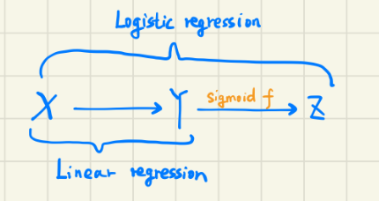
2. What is logistic regression
Logistic regression is a type of regression analysis used for prediction of outcome of a categorical Y based on one or more X. The outcome is usually a binary outcome (1 / 0, Yes / No, True / False).
Notes:
Having classified variables, let's explore logistic regression. Logistic regression is a type of regression analysis used to predict a categorical outcome based on one or more predictors. Typically, the outcome is binary. As illustrated, while regular linear regression estimates a numeric value, logistic regression takes it a step further by converting the obtained numeric value through a function called sigmoid, turning it into a categorical outcome.

Slide 27
3. Example for logistic regression
Problem Statement: Predicting whether a student gets admitted to a university based on their exam scores.
Dataset:
Imagine we have data for 100 students:
Exam 1 Score (continuous X1)
Exam 2 Score (continuous X2)
Admission Result (binary outcome: 1 for Admitted, 0 for Not Admitted)
Logistic Regression Application:
We can use logistic regression to determine the relationship between the two exam scores and the likelihood of getting admitted.
Numeric variable
Numeric variable
Categorical variable
Notes:
Let's consider an example: predicting if a student gets admitted to a university based on their exam scores. Imagine we have data from 100 students, each with scores from two exams. The final admission decision could be represented by 1 (admitted) or 0 (not admitted). This scenario is perfectly suited for our logistic regression model: numeric input variables and a binary categorical output. The relation between the scores and admission probability can be studied using logistic regression.

Slide 28
4. Difference in logistic and linear regression
Linear Regression:
Purpose: Predicts a continuous outcome variable (or dependent variable).
Outcome: A value in a continuous range.
Logistic Regression:
Purpose: Predicts the probability that an observation falls into one of two (or more) categories of a binary or multinomial outcome variable.
Outcome: A probability that the given input point belongs to a particular category.
Notes:
By comparing logistic to linear regression, their differences become clear. Linear regression is used to predict a numeric outcome. The result is typically a number. In contrast, logistic regression predicts the likelihood of a sample belonging to a particular category. The final result is the probability of which category the input belongs to.

Slide 29



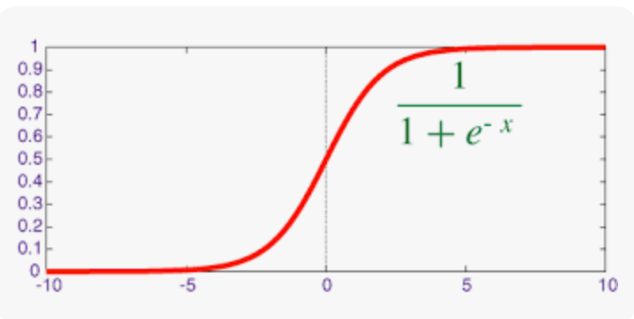
5. Sigmoid function
After we acquire Y in linear regression, we process it using sigmoid function.
After this transform, the outcome will become a number between 0 and 1, which indicates the probability of its category.
Multi-dimensional X input
Notes:
Earlier, we mentioned the sigmoid function's role in transitioning from linear to logistic regression. This function converts the output of traditional linear regression into a probability, making it suitable for logistic regression. The function is defined as 1 over 1 plus e raised to the negative power of x. This function can accept any value from negative infinity to positive infinity, ensuring that any numeric input gets transformed into a value between 0 and 1, representing the probability of a particular category.

Slide 30
Some Characteristics:
S-Shaped Curve: The sigmoid function produces an "S"-shaped curve (called a sigmoid curve).
Output Range: The output of the sigmoid function is in the range (0, 1), making it useful for interpreting the output as a probability.
Centered at 0.5: When the input is zero the output is 0.5, and when input approaches positive infinity, the output approaches 1. and when input approaches negative infinity, output approaches 0.

Slide 31

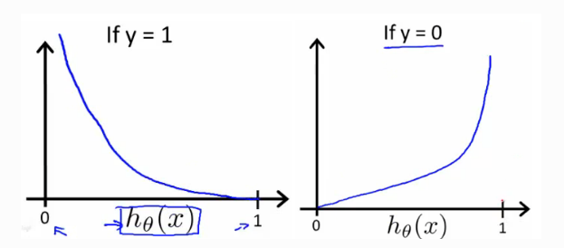
Cost function: Binary Cross Entropy (BCE)
If label y = 1
If label y = 0
Wrong classification High cost
predict = 0
High cost
predict = 1
Low cost
predict = 0
Low cost
predict = 1
High cost

Slide 32
Training Process
X
f(X)
Input
ML Model f
Output
prediction
Update the weight
with Cost Function info
(gradient descent)
Compare by using
Cost/Loss Function
y
label
Objective: Minimize the Cost
Or make Prediction as close to Label as possible

Slide 33
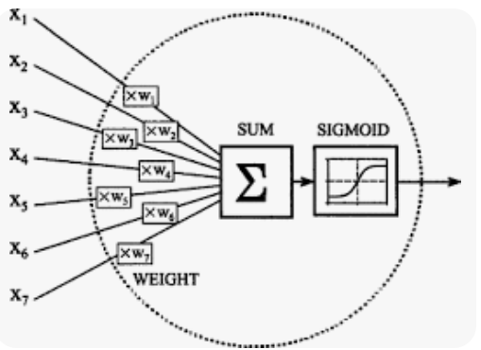
Application
Logistic regression and the sigmoid function have significant roles in the area of deep learning. The perceptron, which is the basic unit in neural network, is based on them.

Slide 34
Code Along Colab notebook
https://colab.research.google.com/drive/1ISgPUCiWXgQAGU3IrAbbjzR-Udug4mLL?usp=sharing

Slide 35
Relevance to Deep Learning
Linear equation, Matrix Multiplication = basis of Neural Network
More linear equations in the model
Cost function = Proper cost function for proper tasks
Gradient Descent = Important in updating the weights in the DL model
Activation Function (Sigmoid)
Linear Regression, Logistic Regression is quick and fast
model.fit()
model.predict()
Deep Learning workshops will go through the whole training process

Slide 36
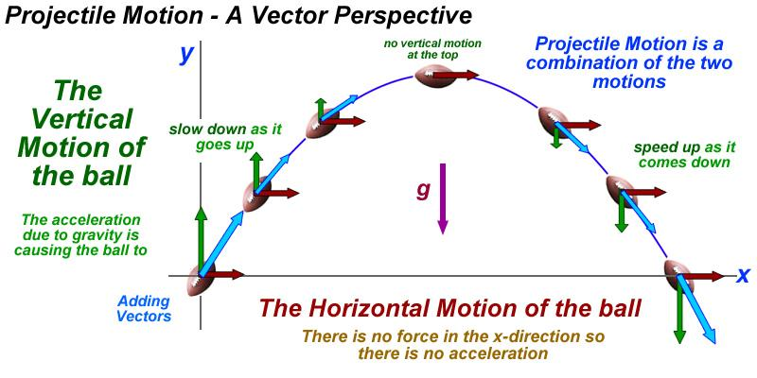
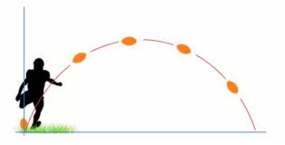

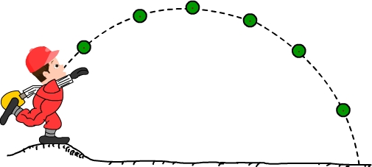
Machine Learning
Analytical solution
Learn from data
Train,
Fit model
Predict
Model

Slide 37
D. Decision tree
Entropy in Information Theory:
The component of decision tree

Slide 38

Entropy in Information Theory:
In information theory, entropy quantifies the amount of uncertainty or randomness associated with random variables. It provides a measure of the average amount of information needed to represent an outcome of a random variable.
For a discrete random variable X and probability distribution P(x), the Entropy H(x) is defined as:
Where usually b=2

Slide 39

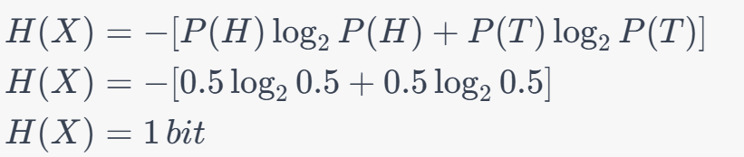
Let’s explain this formula using a simple example:
Imagine you have a fair coin that you're going to toss.
Probability of Heads (H) = 0.5
Probability of Tails (T) = 0.5
Entropy:

Slide 40
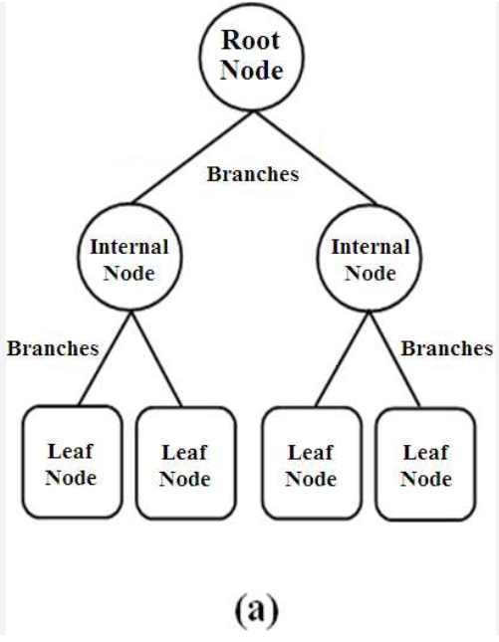
2. The component of decision tree

Slide 41
Gradient Descent: use Cost Function to update Weights
Differentiate Cost/Loss against Weight
How a change in weight affect the Cost/Loss
Visualization for 1 weight but this is done for all weights: w1,...wn

Slide 42
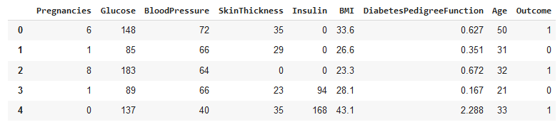
Terminologies
X: the input data as a whole
With many data points, samples
With many features, attributes
large multi-dimensional array (tabular data, words text vector embedding, images array)
y : the “output”
Y_predict or f(x): the output from the model
Y_label: the label given in the data
y
Columns: features
Rows: Data points

Slide 43
Iterations
Continuously use gradient descent to find the best set of weights: w1, w2, …

Slide 44
Machine Learning by task
Regression
Continuous:
output/label y is on a continuous range
Classification
Discrete categories
output/label y is categorical, discrete
Appropriate Cost function should be used for each task

Slide 45
Workflow
Data
Define the problem
Data acquisition, pre-process, clean (many ways)
Model setup
(Hypothesis)
Based on the problem, pick a technique: Linear Reg, Logistic Reg, Deep Learning,... (many ways)
Set up relevant Cost function accompanied with the model
New model
New hypothesis
Fit the data in the model
Split the data into train test
Go through the training loop, fitting the data
Evaluate the model
Use metrics to evaluate the model, the hypothesis
If meet requirements, used in real-life
Inference, predict in real-life

Slide 46
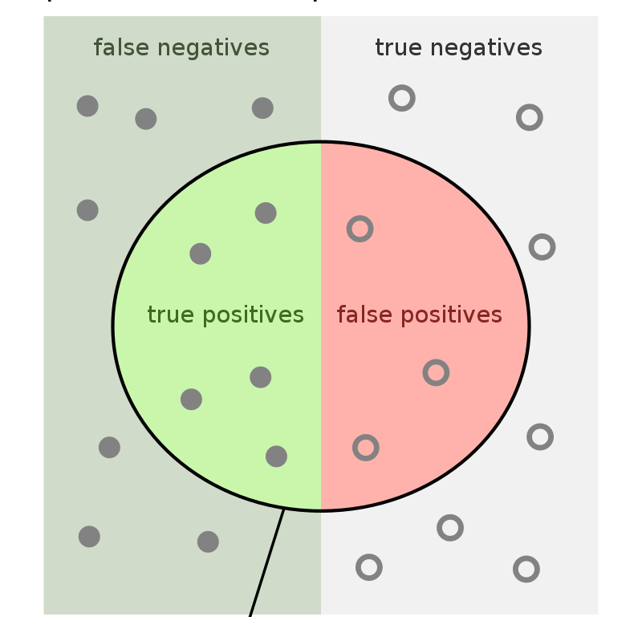

Classification: Precision Recall
The classification the model
PREDICT
Classification that is
TRUE

Slide 47
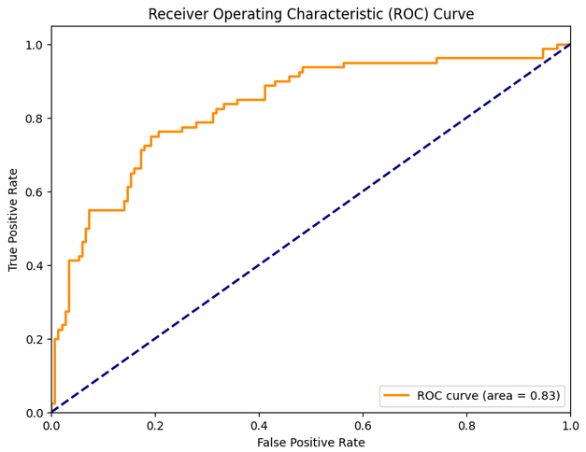
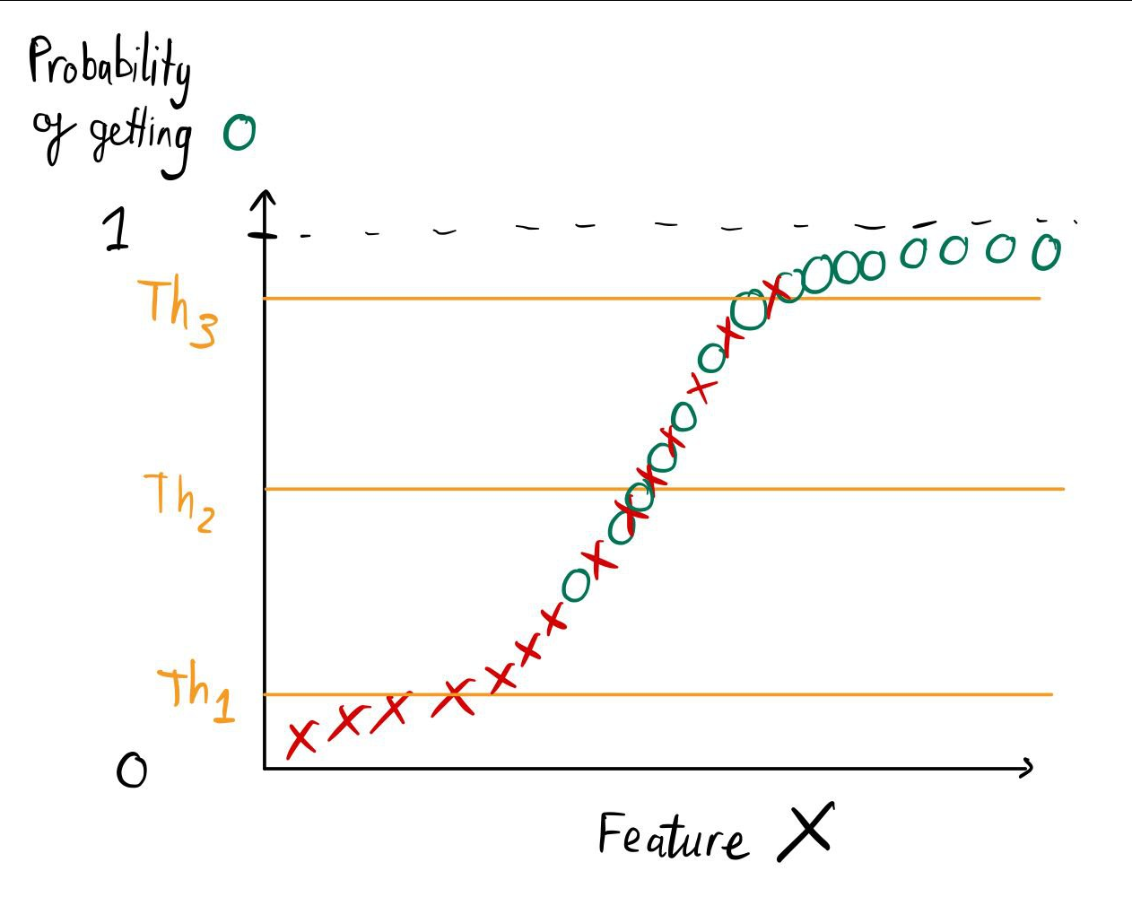
Classification: ROC-AUC
Good
True positive = O above threshold
False positive = X above threshold
Th1
Th2
Th3
Bad

Slide 48
References
https://ml-cheatsheet.readthedocs.io/en/latest/index.html

